Slide 1
Microsoft Power BI

Slide 2
Power BI Embedding Best Practices with the Power BI JavaScript API
Ted Pattison
Principal Program Manager
Power BI Customer Advisory Team (PBICAT)

Slide 3
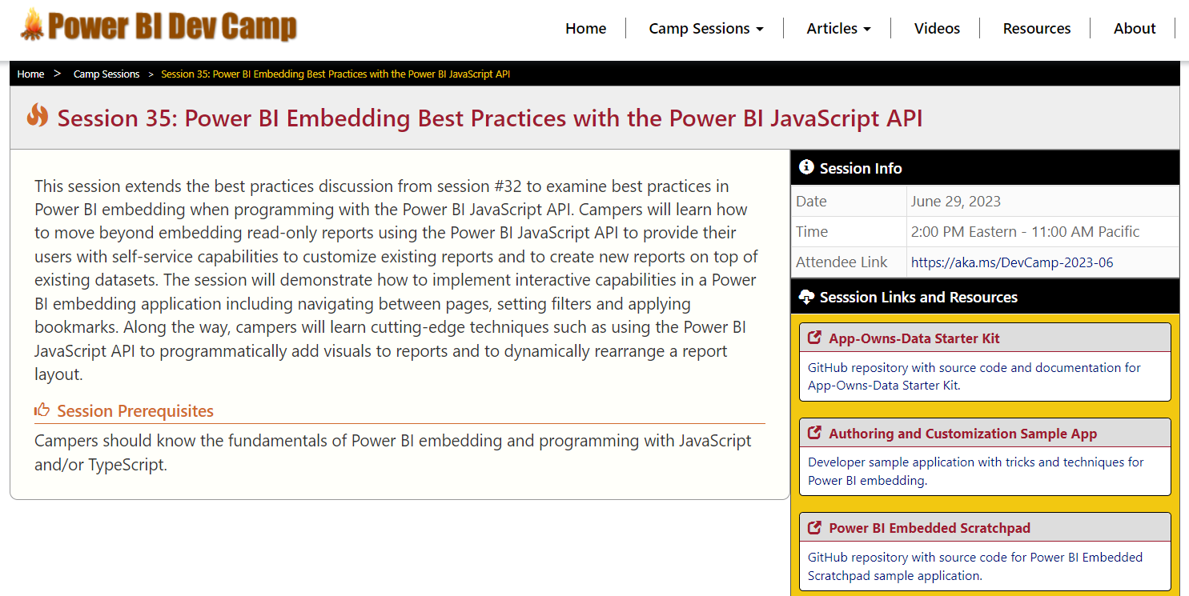
Welcome to Power BI Dev Camp
Power BI Dev Camp Portal - https://powerbidevcamp.net
There is a page for each session with links to samples, slides and other resources

Slide 4
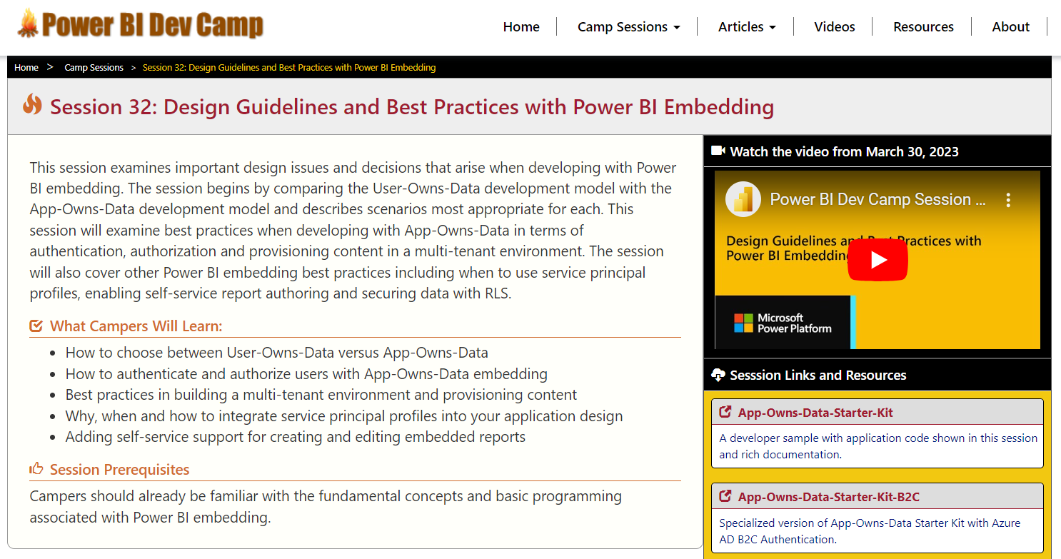
This Session Builds on Previous Session #32
Session 32: Design Guidelines and Best Practices with Power BI Embedding
https://www.youtube.com/watch?v=1y1KkqFchBc
This session continues discussion focusing on client-side code used for embedding

Slide 5
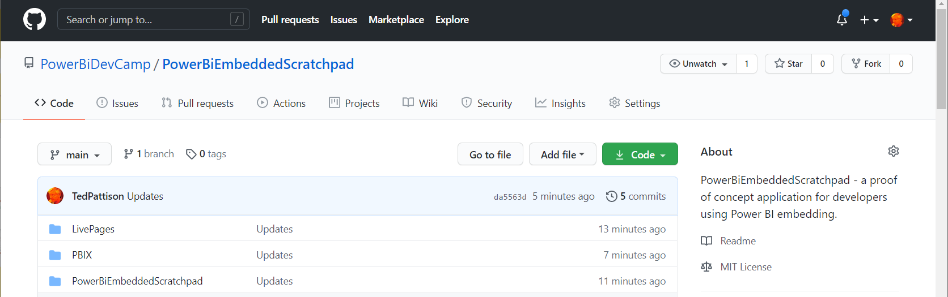
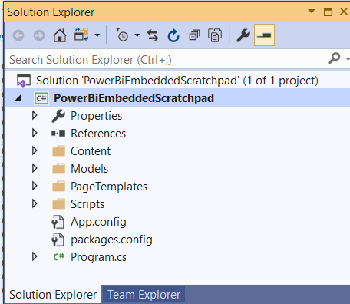
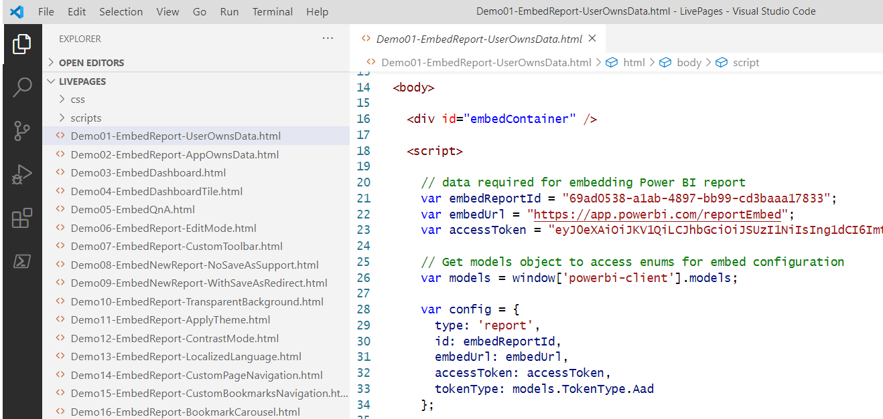
Sample #1: PowerBiEmbeddedScratchpad
https://github.com/PowerBiDevCamp/PowerBiEmbeddedScratchpad
Running App Create Test Pages

Slide 6
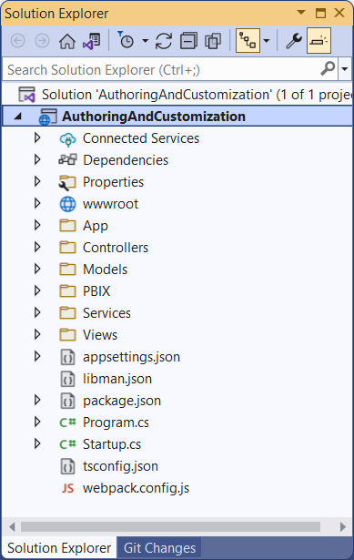
Sample #2: AuthoringAndCustomization
Developer sample demonstrates App-Owns-Data embedding techniques
Implemented as C#/.NET6 web application which uses the Power BI .NET SDK
Originally created for Session 21: Report Authoring and Customization with Power BI Embedding
Download from https://github.com/PowerBiDevCamp/PBIE-Authoring-And-Customization
{F5}

Slide 7
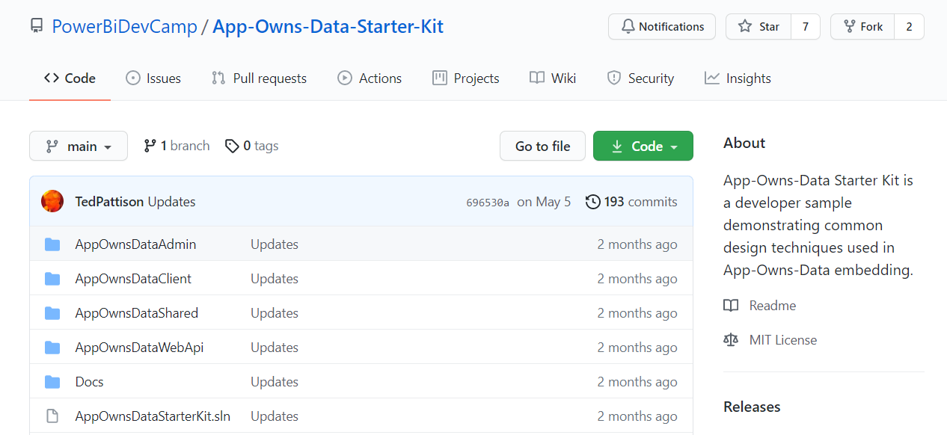
Sample #3: App-Owns-Data Starter Kit
All source code and documentation available through public GitHub repository
https://github.com/PowerBiDevCamp/App-Owns-Data-Starter-Kit
There is a second repository with a version specialized to use Azure AD B2C
https://github.com/PowerBiDevCamp/App-Owns-Data-Starter-Kit-B2C

Slide 8
Agenda
Power BI Embedding Fundamentals
Initializing an Embedded Session
Providing Interactive Behavior
Enabling Self-service Report Authoring
Leveraging Dynamic Report Binding
Extending Client-side Code using Custom Web APIs

Slide 9
Power BI Embedding – The Big Picture
User launches your app using a browser
App authenticates with Azure Active Directory and obtains access token
App uses access token to call to Power BI Service API
App retrieves data for embedded resource and passes it to browser.
Client-side code uses Power BI JavaScript API to create embedded resource
Embedded resource session created between browser and Power BI service
5
Power BI Service
Browser
iFrame
6
4
4
3
1
Your App
2
Azure AD

Slide 10
Power BI JavaScript API (powerbi.js)
Power BI JavaScript API used to embed resources in browser
Client-side JavaScript API required to develop with Power BI embedding
Documentation is titled Power BI embedded analytics Client APIs https://docs.microsoft.com/en-us/javascript/api/overview/powerbi/

Slide 11
User-Owns-Data Embedding vs App-Owns-Data Embedding
User-Owns-Data Embedding
All users require a Power BI license
Useful in corporate environments
App authenticates as current user
Your code runs with user’s permissions
User’s access token passed to browser
App-Owns-Data Embedding
No consumers require Power BI license
Useful for commercial applications
App authenticates with app-only identity
Your code runs with admin permissions
Embed token passed to browser
User-Owns-Data Embedding for use within Organization
App-Owns-Data Embedding for use by ISVs
Browser
Power BI Service
Browser
Power BI Service
iFrame
Azure AD
Access Token
for the current user
iFrame
Power BI
Embed Token
for specific report

Slide 12
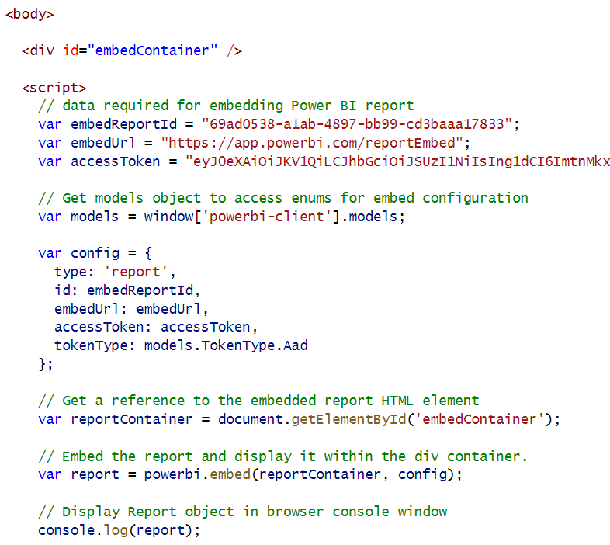
User-Owns-Data Embedding

Slide 13
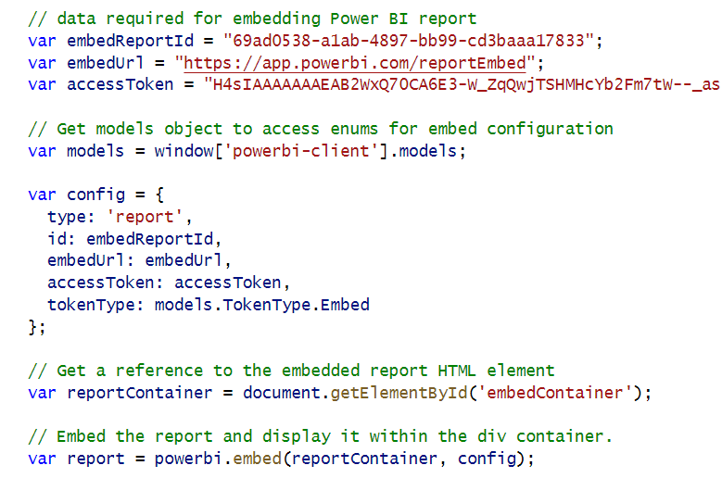
App-Owns-Data Embedding

Slide 14
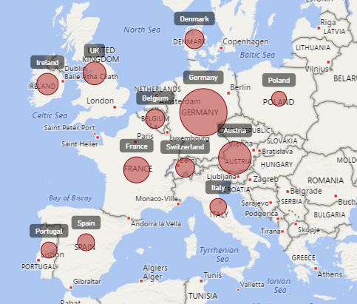
Report Embedding Architecture
Embedding involves creating an iFrame on the page
PBI.JS transparently creates iFrame and sets source to URL to Power BI Service
The iFrame and hosting page originate from different DNS domains
https://app1.mydomain.com
Your HTML and CSS
Web Hosting Server
Your
JavaScript
iFrame
Embedding Data
https://wabi-us-east2-redirect.analysis.windows.net/
powerbi.js
Power BI Service

Slide 15
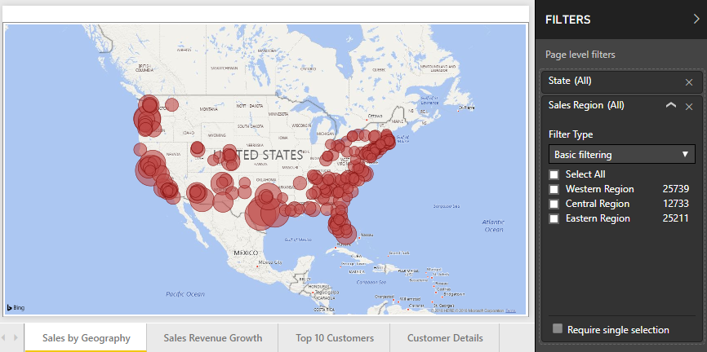
A Promise-based Programming Model
Design of PBIJS simulates HTTP protocol
Creates more intuitive programming model for developers
Programming based on asynchronous requests and promises
Embedded objects programmed using actions and events
Actions
report.fullscreen
report
report.switchMode
report.setFilters
Your
JavaScript
report.getPages
Events
report.loaded
report.pageChanged
report.commandTriggered

Slide 16
Exploring powerbi.js Events
Demo01 registers event handlers for all supported powerbi.js events
Use it to gain understanding of which user actions trigger specific events
Event arguments logged to console window for easy inspection

Slide 17
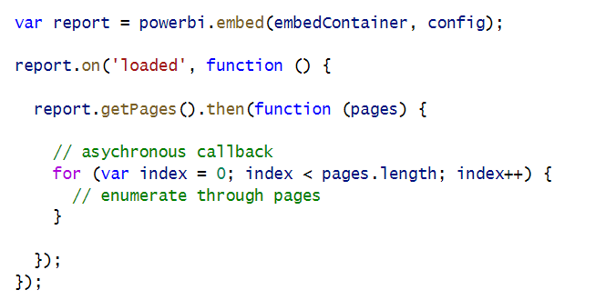
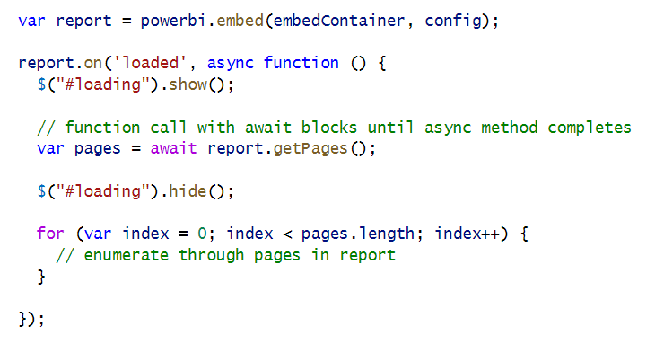
Calling report.getPages() in the loaded event
Old-school approach - Call as asynchronous method and pass callback function
Modern approach – Call asynchronous method using async and await keywords

Slide 18
Agenda
Power BI Embedding Fundamentals
Initializing an Embedded Session
Providing Interactive Behavior
Enabling Self-service Report Authoring
Leveraging Dynamic Report Binding
Extending Client-side Code using Custom Web APIs

Slide 19
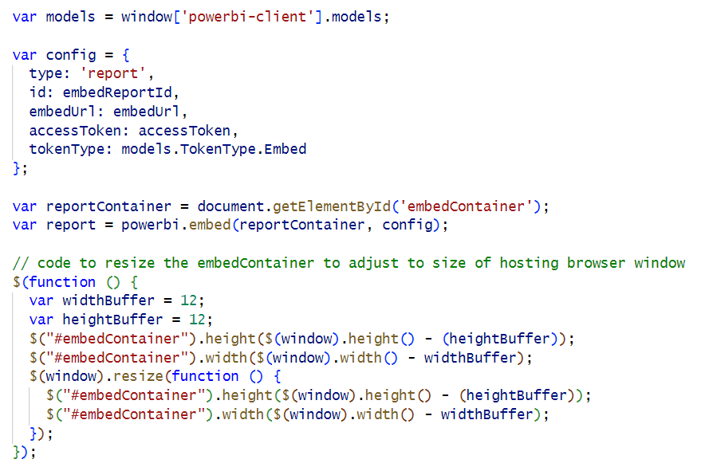
Write Code To Adjust Size of embedContiner DIV
Ensure your DIV has the correct width and height
Embedding report using powerbi.embed() alone will not adjust height of embedContiner DIV
Adding client-side code to adjust DIV width and height ensure better user experience

Slide 20
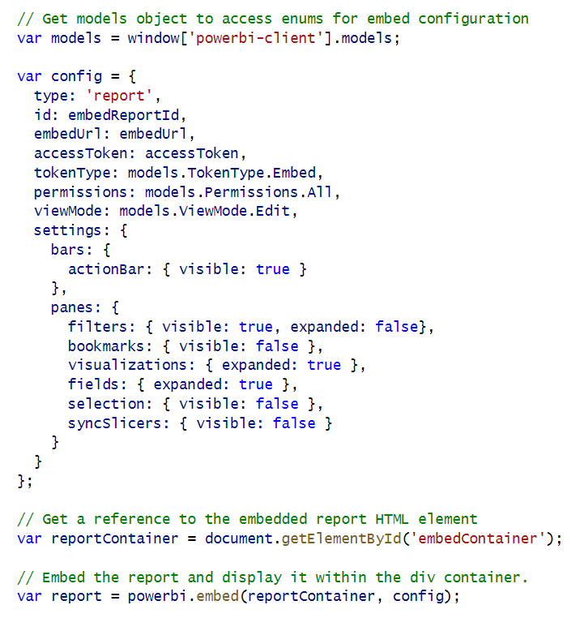
Initializing Panes When Embedding a Report
Report panes and action bar can be set in config object
Filter pane and Bookmarks pane are only panes available in View mode
Other panes are only available when report is in Edit mode

Slide 21
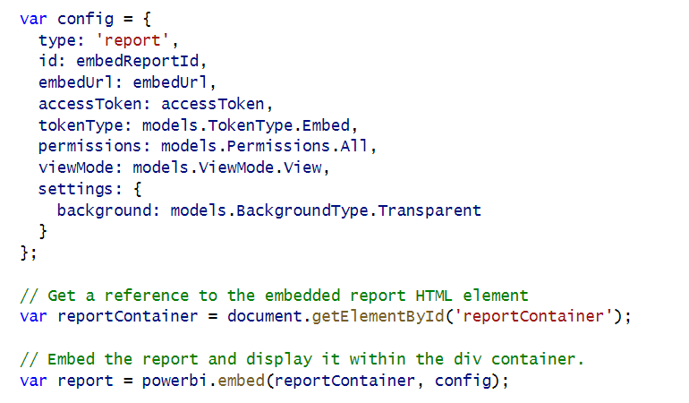
Embed Report with Transparent Background

Slide 22
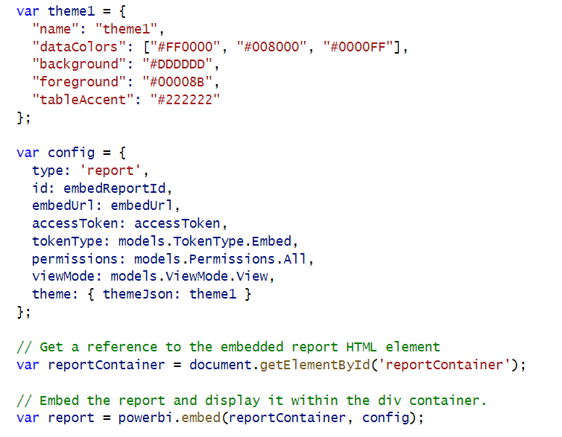
Applying Report Themes

Slide 23
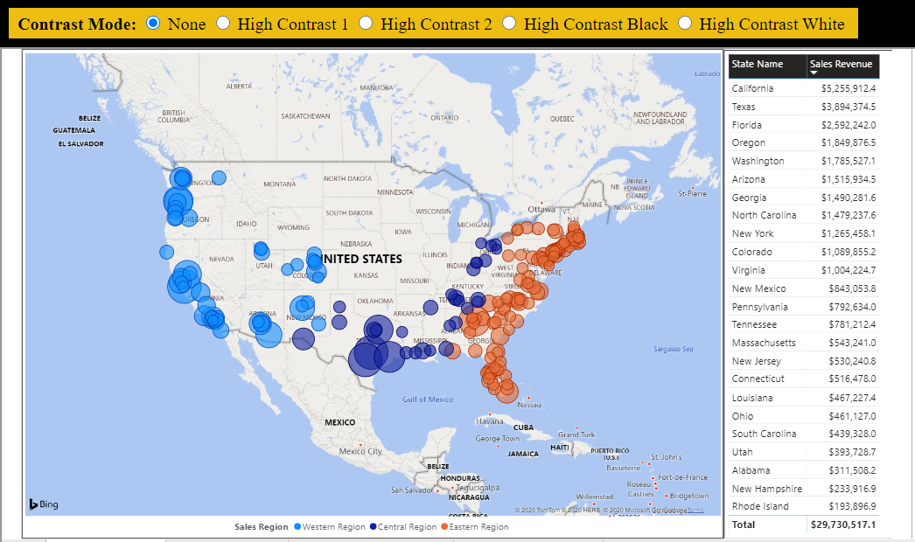
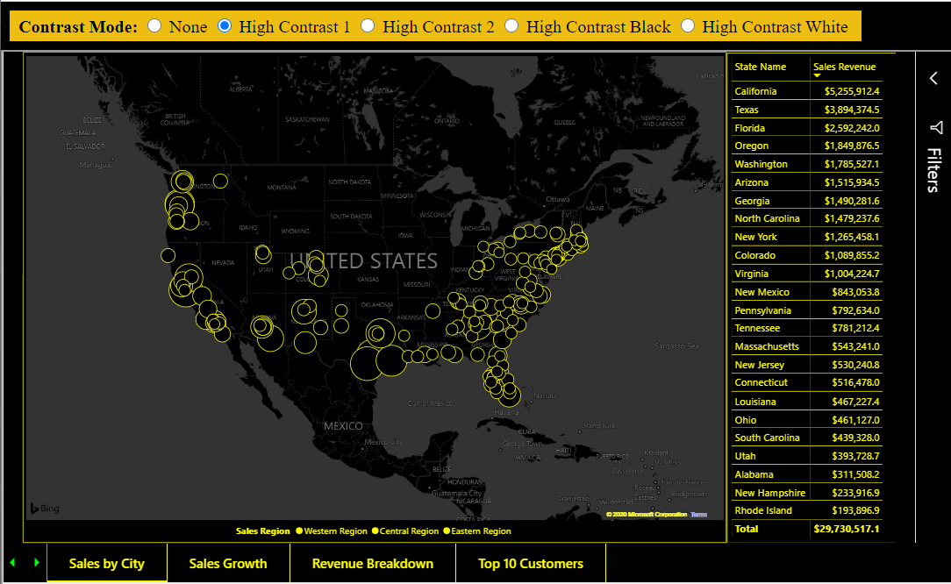
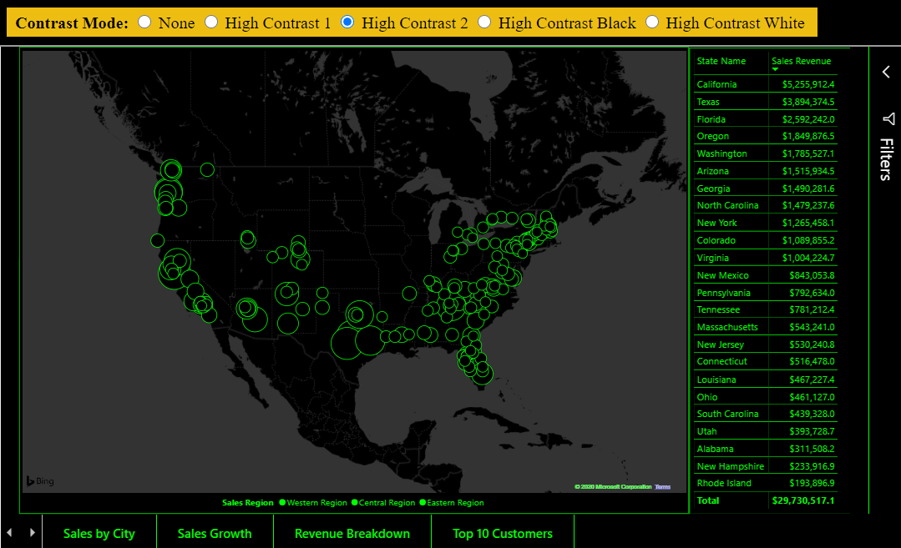
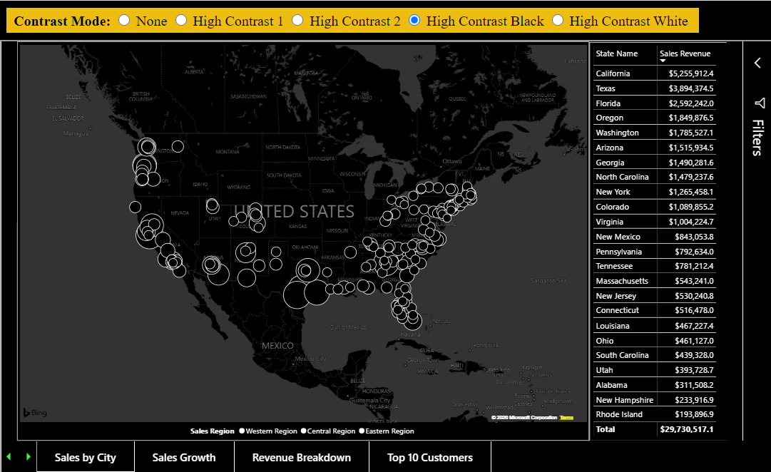
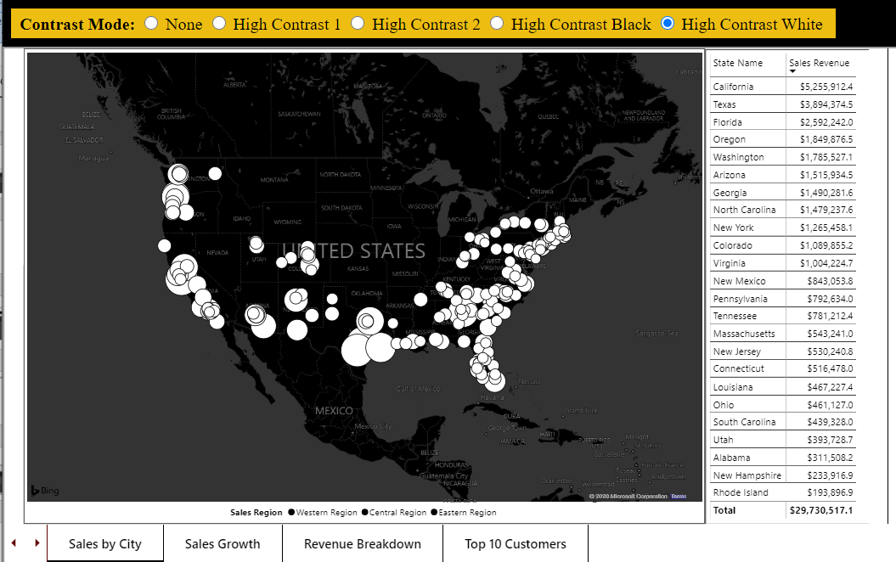
Contrast Mode

Slide 24
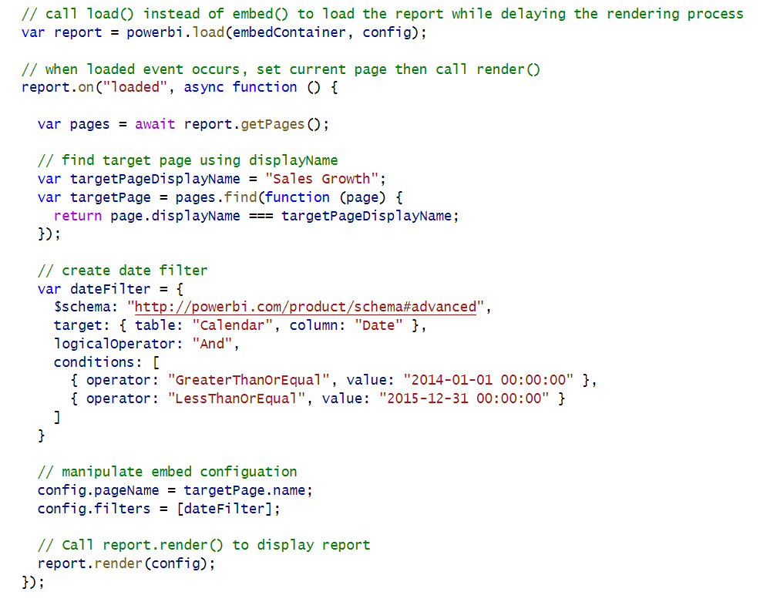
Phased Embedding
Phased embedding allows you to update report settings it is rendered to user
Report loading process started with powerbi.load() instead of powerbi.embed()
Implementation requires a call to report.render() in the handler for the loaded event
Commonly used to navigate to a specific page or to set a filter while loading

Slide 25
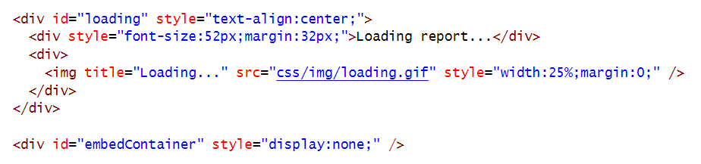
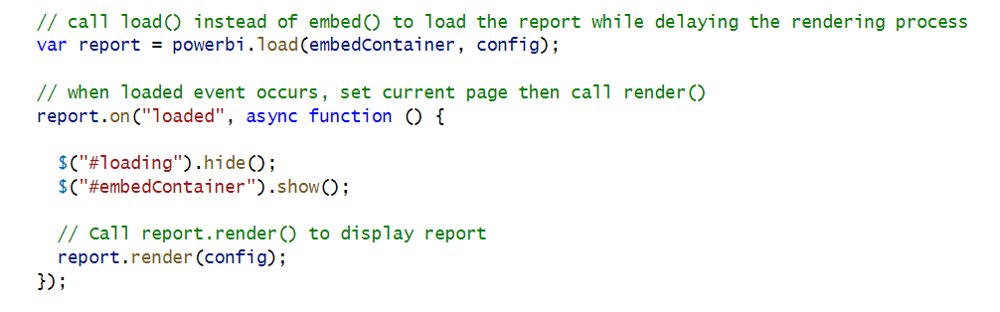
White Label Report Loading
Technique uses phased embedding to hide Power BI logo during loading process

Slide 26
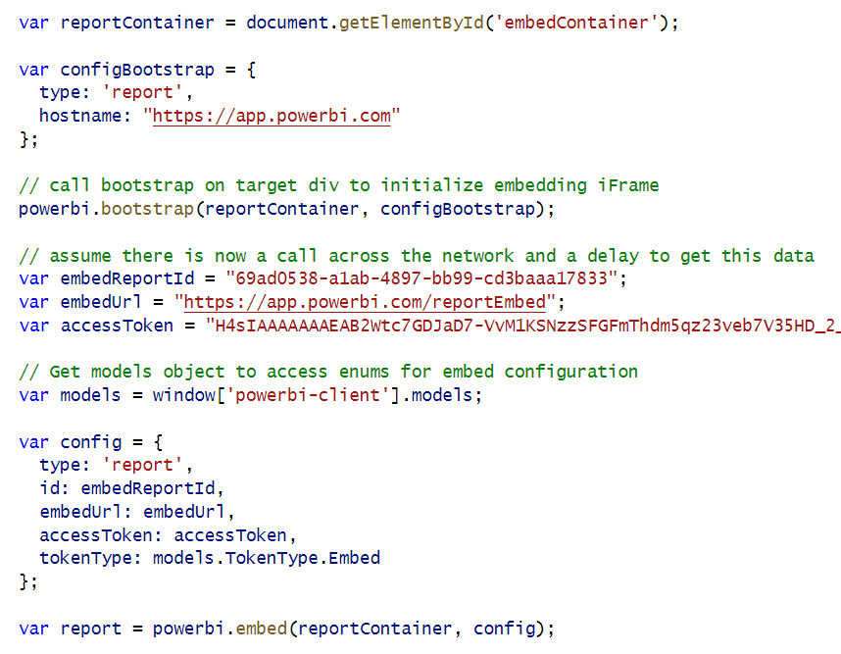
Bootstrap Optimization in Report Loading
Small optimization to preload standard JavaScript into target DIV container

Slide 27
Best Practice – Use Only One iFrame per Web Page
Each embedded report on a host web page has overhead
In loading phase, report acquires metadata and security token for executing queries
In rendering phase, visuals begin executing queries
Rendering phase completes when last visual completes its query
"Embed a Visual" is actually embedding host report behind the scenes
embedding multiple visuals == embedding multiple reports
Use Custom Layout with single report page
Requires extra code to hide, show and position visuals
Provides flexible UI layout while running inside single iFrame

Slide 28
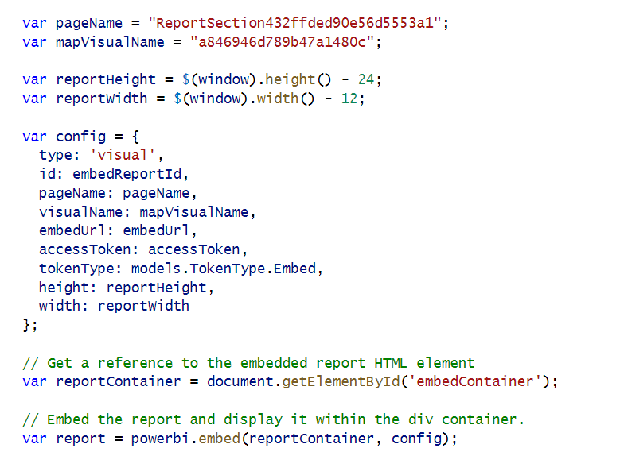
Embedding a Single Visual
Try and limit this approach to one embedded visual per page – this will not scale due to overhead

Slide 29
Getting the Names of Pages and Visuals
Demo06
You can discover page names and visual names using Demo01 events explorer
In some scenarios, you might want to hard-code page and visual names into your code

Slide 30
Creating a Static Custom Layout
Demo06
You can set x position, y position, width and height for each visual in a custom layout

Slide 31
Creating a Custom Layout without Hard-coded IDs
Demo06

Slide 32
Displaying Single Visual using Custom Layout
Create a custom layout that only display a single visual
Visual can be sized to full width and height of report
Use defaultLayout to hide all other visuals by default.

Slide 33
Agenda
Power BI Embedding Fundamentals
Initializing an Embedded Session
Providing Interactive Behavior
Enabling Self-service Report Authoring
Leveraging Dynamic Report Binding
Extending Client-side Code using Custom Web APIs

Slide 34
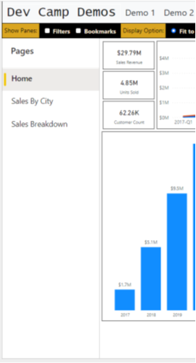
Report Navigation Settings
Demo02
You can show or hide page-based navigation menu used in Power BI Service
Page navigation can be shown on left side of page or bottom of page
set navigation
left navigation
bottom navigation

Slide 35
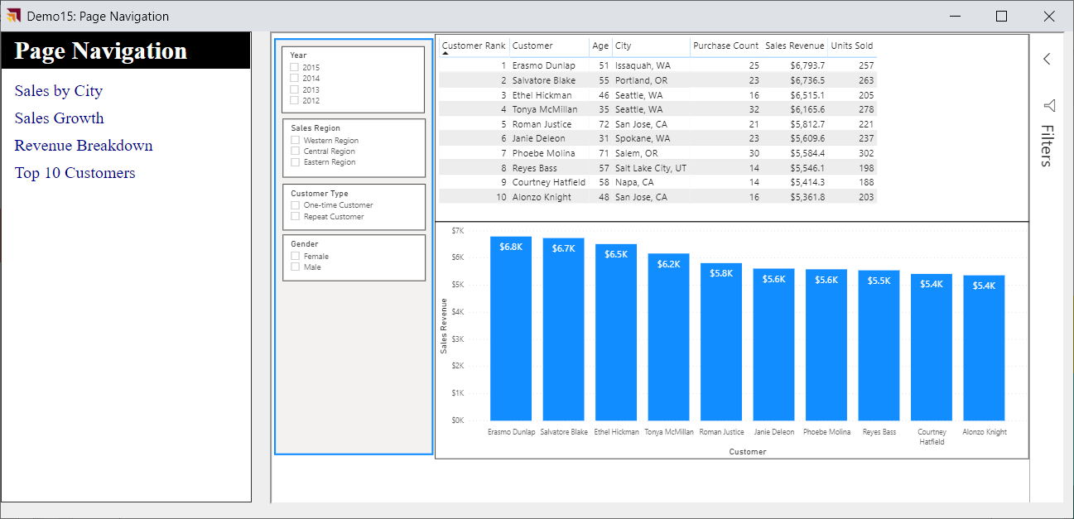
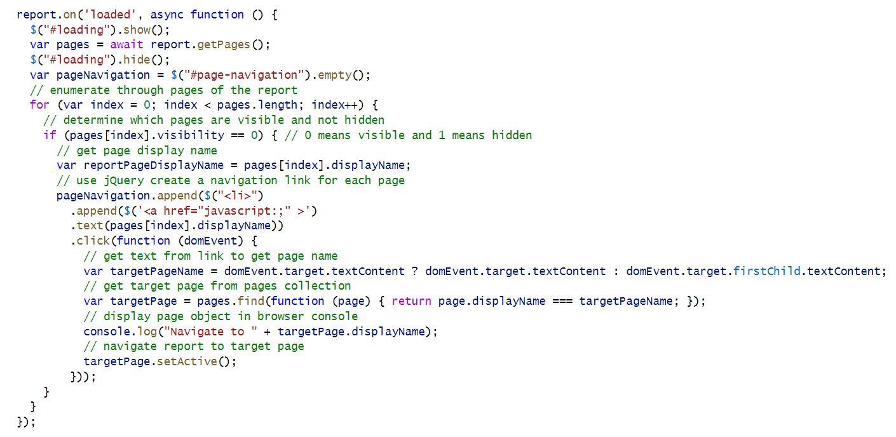
Custom Page Navigation

Slide 36
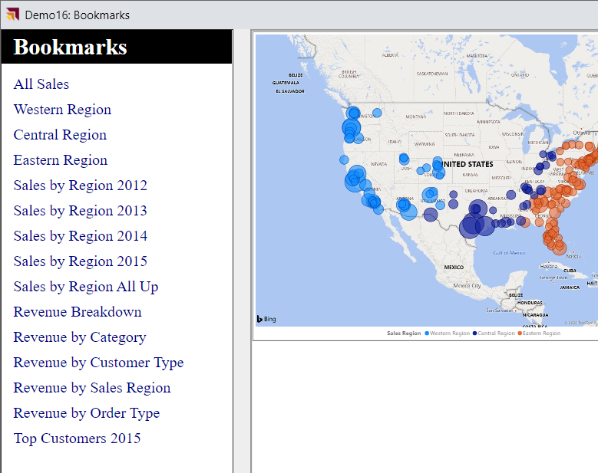
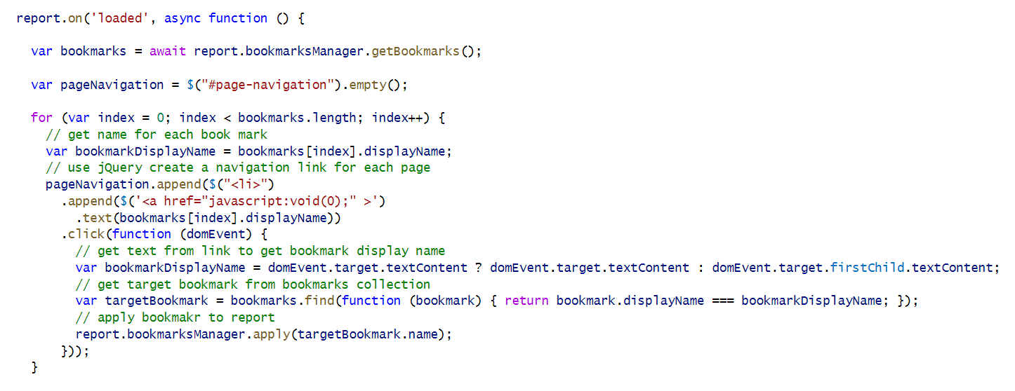
Custom Bookmark Navigation

Slide 37
Creating a Custom Navigation Scheme
Custom Navigation can be added using pages or bookmarks

Slide 38
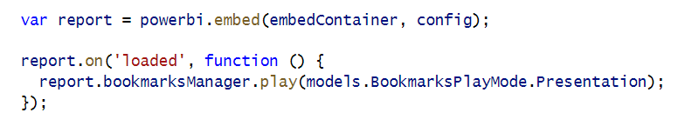
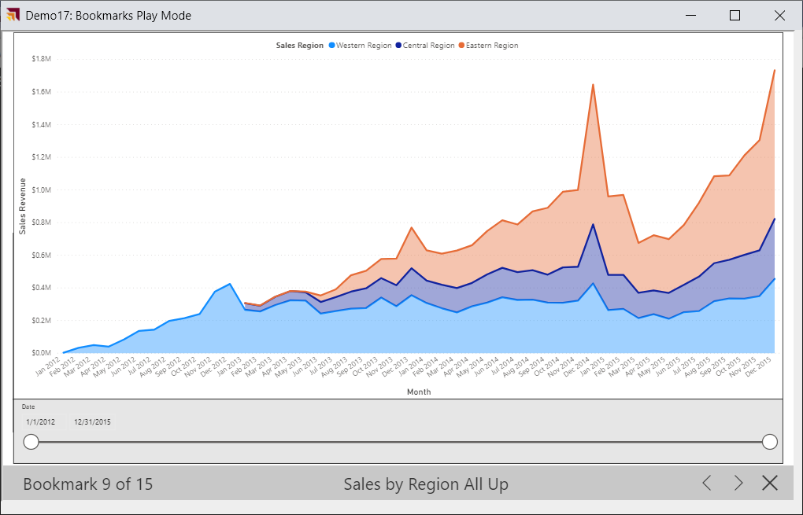
Bookmark Play Mode

Slide 39
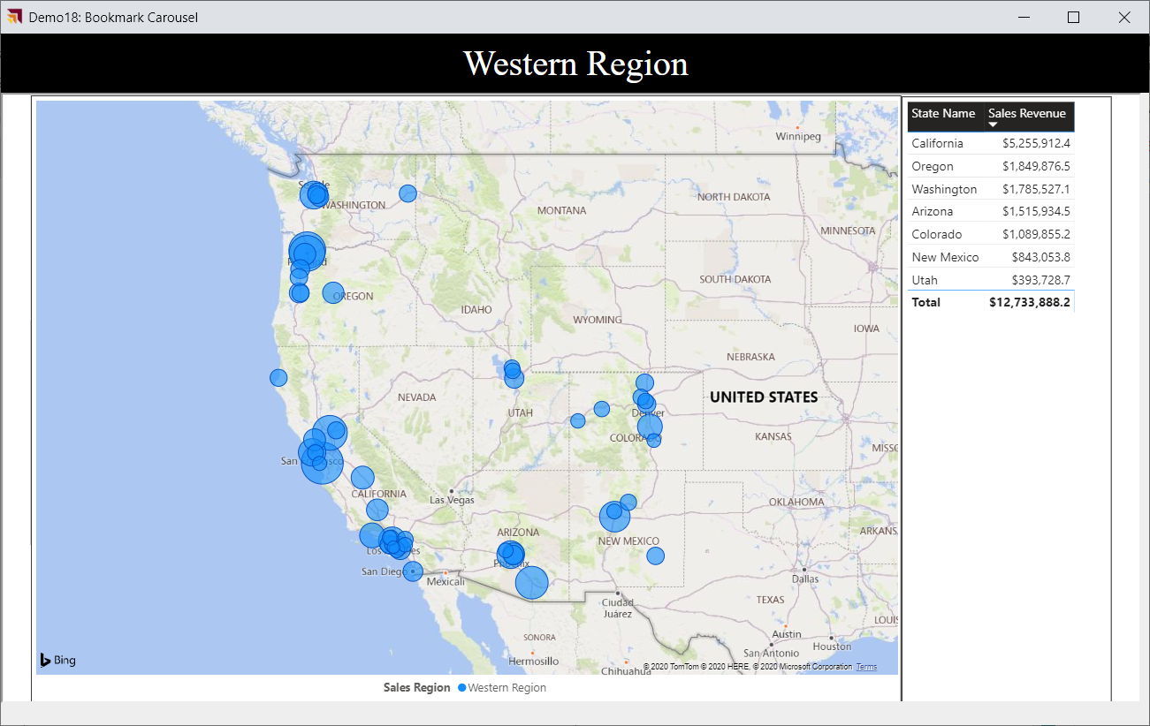
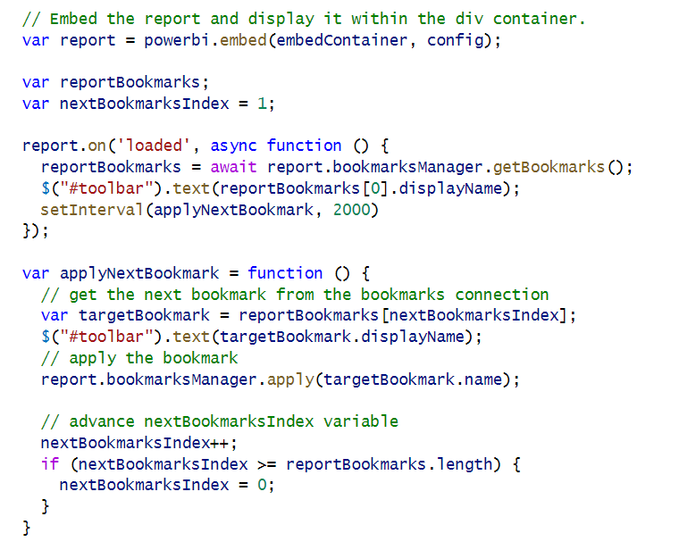
Bookmark Carousel

Slide 40
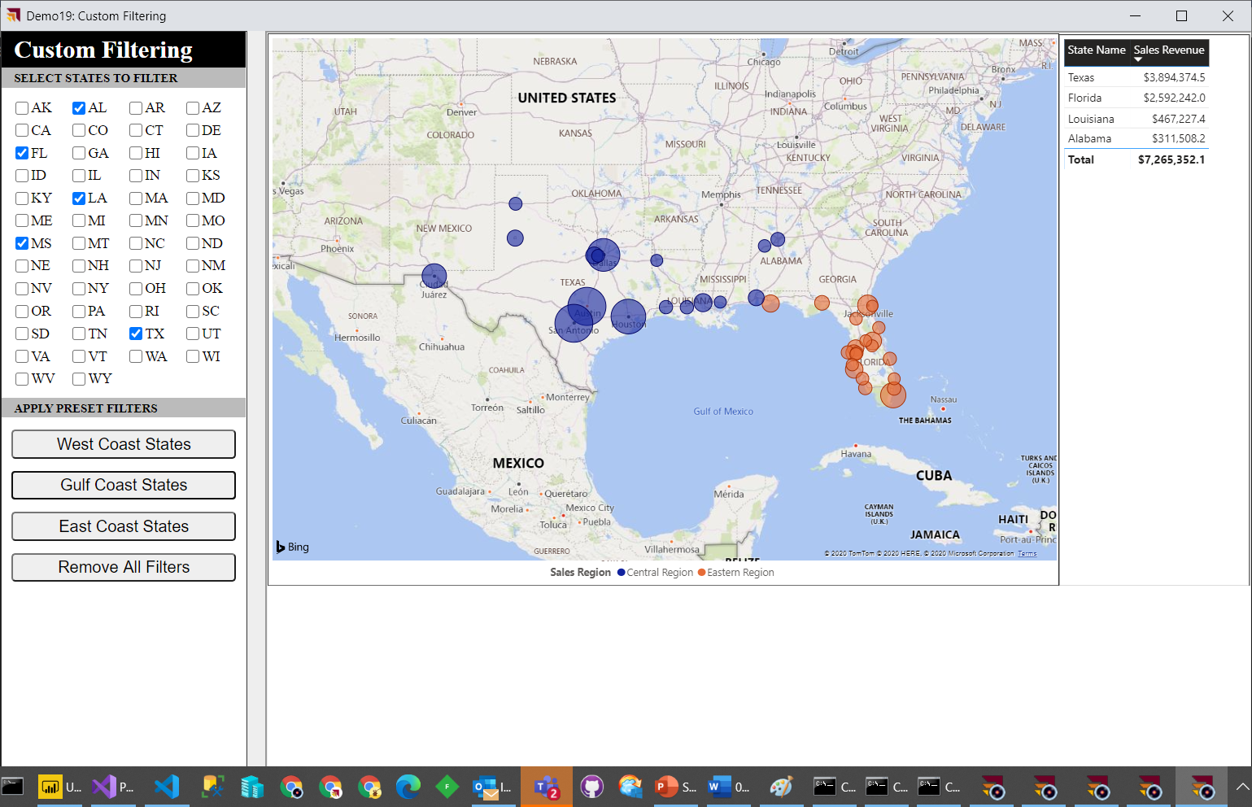
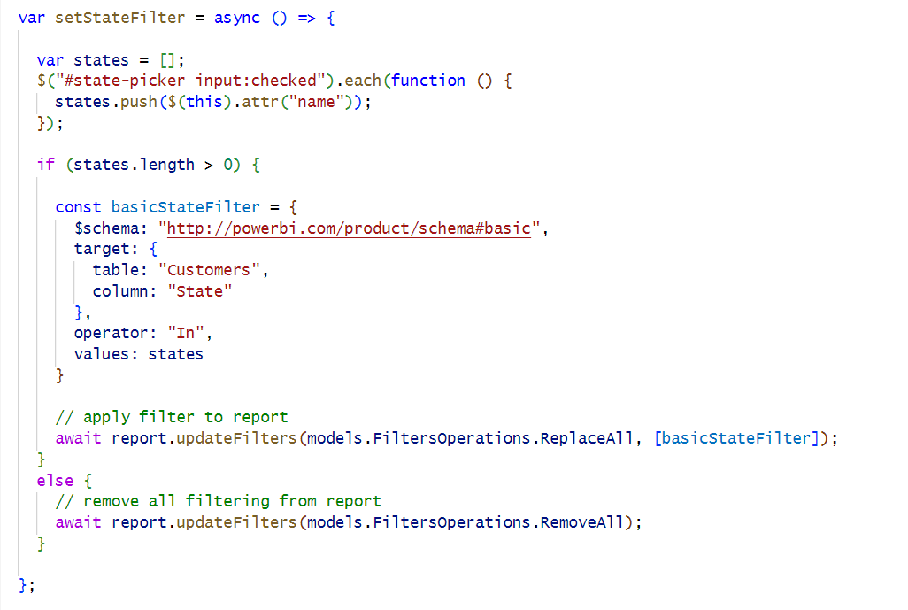
Implementing a Custom Filtering Experience

Slide 41
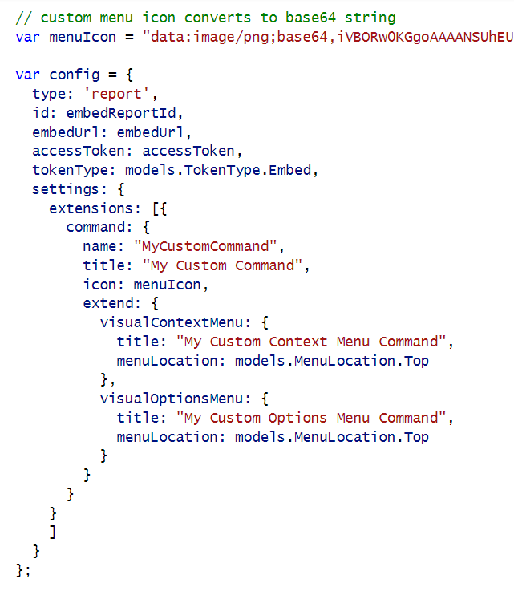
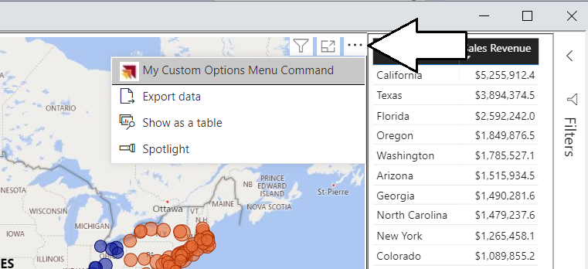
Adding Visual Menu Commands

Slide 42
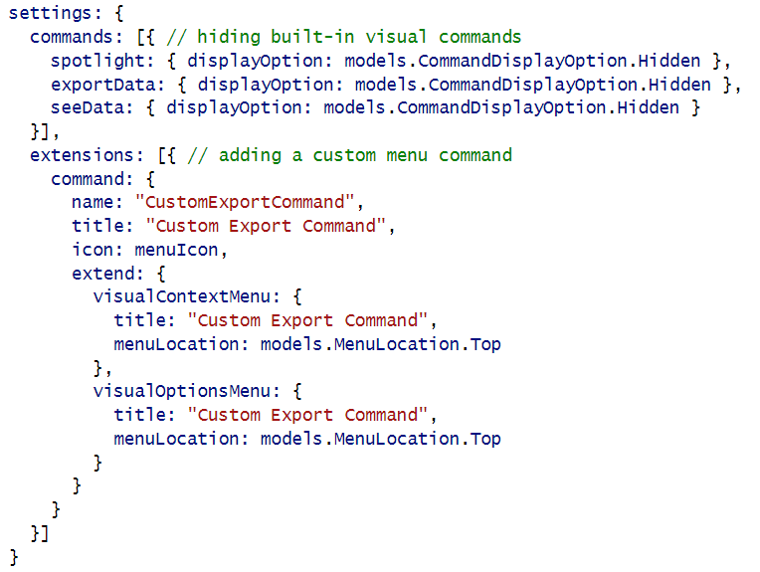
Hiding Built-in Visual Menu Commands

Slide 43
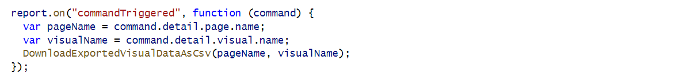
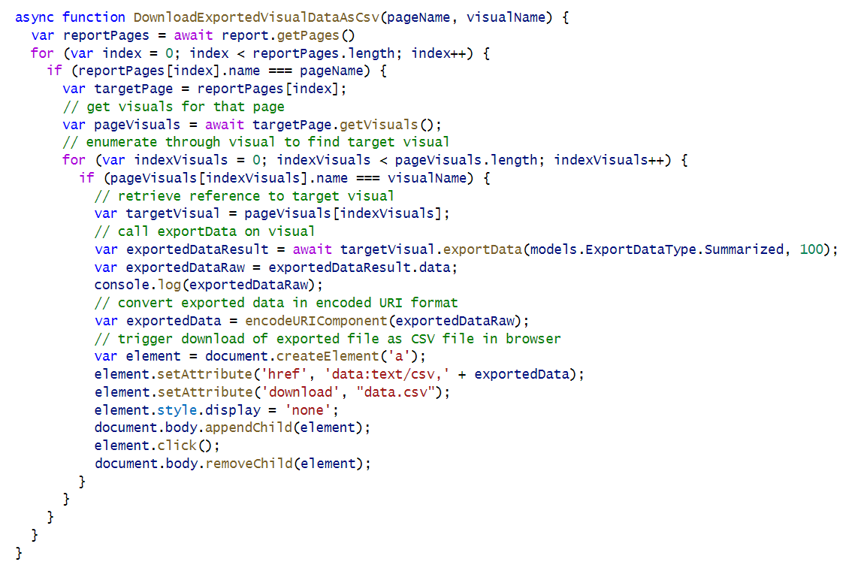
Create a Custom Visual Export Command

Slide 44
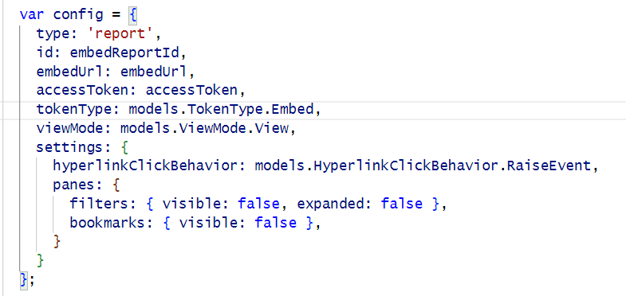
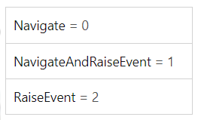
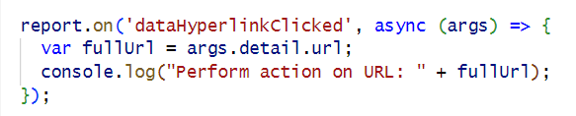
Using hyperlinkClickBehavior Configuration Option

Slide 45
Agenda
Power BI Embedding Fundamentals
Initializing an Embedded Session
Providing Interactive Behavior
Enabling Self-service Report Authoring
Leveraging Dynamic Report Binding
Extending Client-side Code using Custom Web APIs

Slide 46
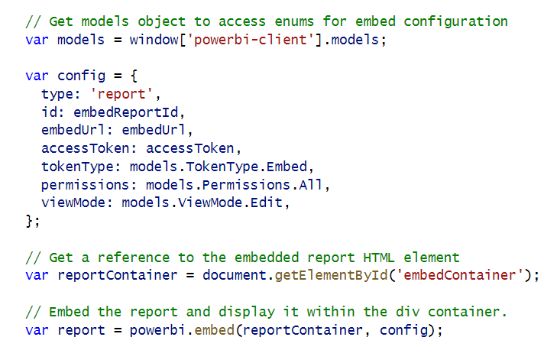
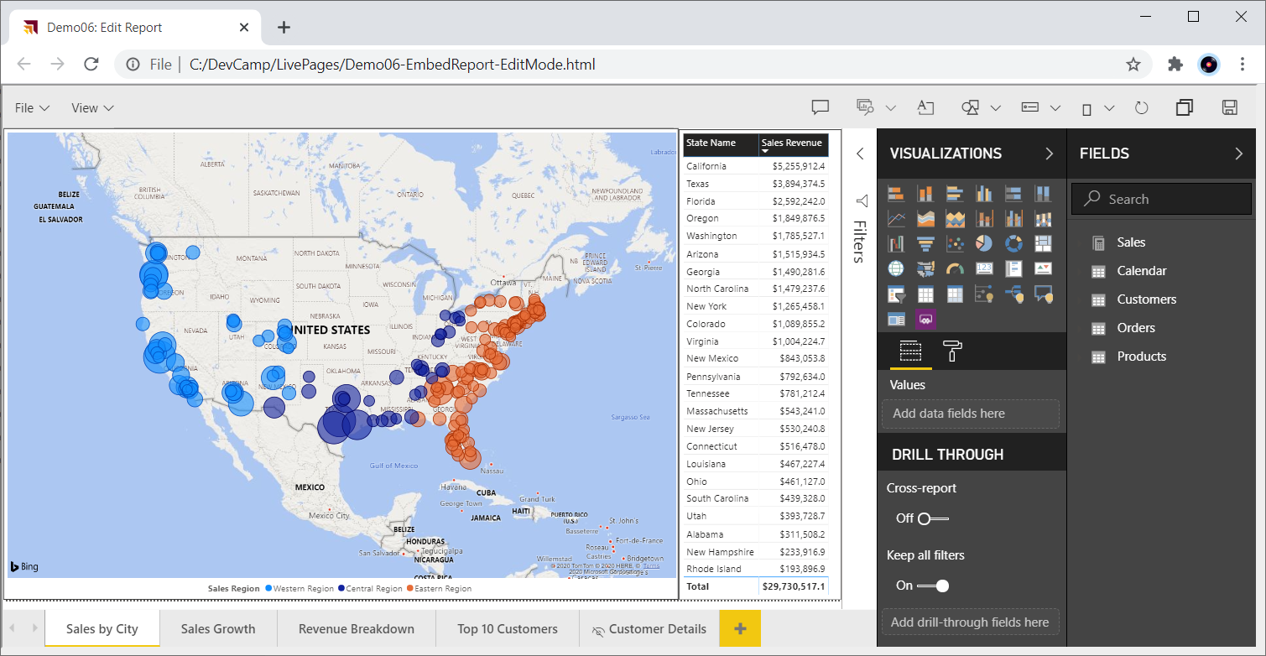
Embedding Reports in Edit Mode

Slide 47
Moving a Report into Edit Mode
Demo03
Report can be opened in Edit mode or switched into Edit mode after opening
Minimal code required to switch report into Edit mode
For user to perform Save operation, embed token must have reportId with allowEdit set to true
For user to perform Save As operation, embed token must include workspaceId

Slide 48
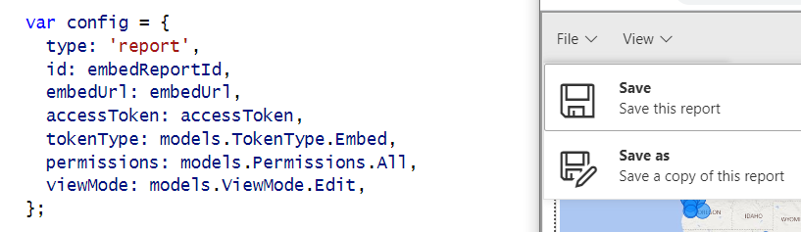
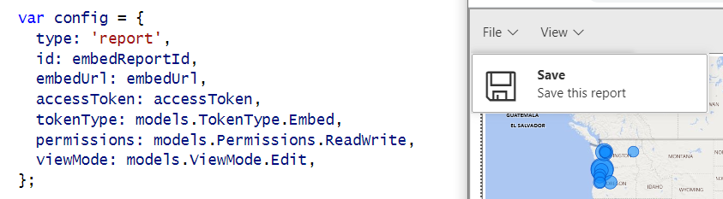

Showing and Hiding the Save and Save as Menus
Demo03
permissions: models.Permissions.All
permissions: models.Permissions.ReadWrite
permissions: models.Permissions.Copy

Slide 49

New Report with Save As Redirect – User-Owns-Data

Slide 50
Implementing the Save-As Redirect – App-Owns-Data
saved event fires on both Save and SaveAs actions.
Call to EmbedTokenController Web API to get new embed token with the report ID of the new report

Slide 51
GetEmbedToken
Demo03
Create token request object collections
add IDs for workspaces
add all dataset IDs from source workspace
add all report IDs from source workspace
add all report IDs from target workspace
Create GenerateTokenRequestV2 object
Call Power BI REST API to generate token
Return token to caller as a string

Slide 52
Using a Custom SaveAs Dialog
Demo04
Power BI embedding supports using custom Save As dialog
saveAsTriggered event fires when user in selects Save As command from action bar
Your code must display custom dialog and then execute report.SaveAs

Slide 53
Saving Copy of Report to a Target Workspace
Demo04
When calling report.SaveAs, you can specify a target workspace
Customized reports can be saved and maintained in different workspaces
Embed token requires workspace ID for target workspace

Slide 54


Embed a New Report

Slide 55
Agenda
Power BI Embedding Fundamentals
Initializing an Embedded Session
Providing Interactive Behavior
Enabling Self-service Report Authoring
Leveraging Dynamic Report Binding
Extending Client-side Code using Custom Web APIs

Slide 56

Using Dynamic Report Binding
Guidelines
Create dataset with common schema for each customer in isolated customer workspace
Maintain one set of reports in shared workspace
Use dynamic binding to connect shared report to client-specific dataset
ADD DIAGRAM
shared workspace
shared report
empty dataset
workspace – customer 1
dataset 1
workspace – customer 2
dataset 2
workspace – customer 3
dataset 3

Slide 57
Agenda
Power BI Embedding Fundamentals
Initializing an Embedded Session
Providing Interactive Behavior
Enabling Self-service Report Authoring
Leveraging Dynamic Report Binding
Extending Client-side Code using Custom Web APIs

Slide 58

Extend Client-side Code using Web APIs
Each AuthoringAndCustomization demo page runs as a Single Page Application (SPA)
HomeController returns HTML for each page along with JavaScript viewModel with embedding data
Some demo pages require Web API callbacks after initial page has loaded
Demo08 includes Web API callbacks that read and write to underlying SQL database
HomeController
EmbedTokenController
Bookmarks Controller
AppOwnsDataCustomizationDB

Slide 59
Capturing a Custom Bookmark
Demo07

Slide 60
Demo08 demonstrates persisting bookmarks in database
Application design support Shared Bookmarks and Personal Bookmarks
Shared bookmark seen by all report consumers
Personal bookmark only seen by user that created it
Bookmarks Controller
SharedBookmarks
table
PersonalBookmarks
table

Slide 61
Tables for Persisting Custom Bookmarks
SharedBookmarks table
PersonalBookmarks table

Slide 62
Loading with Persisted Bookmarks
Demo08

Slide 63
Adding Personalized Report Subscriptions
Demo08
With App-Owns-Data embedding, Power BI does not know user identity
App-Owns-Data embedding does not provide SaaS-style personalization features
Personalization features must be fully implemented by developer
Let's explore application design to support personalized report subscriptions
Start by allow users to save subscription information to ReportSubscriptions table
Implement subscriptions service to read to ReportSubscriptions table and export reports
PDF files for exported reports can be sent to users via email attachment

Slide 64
Provide Users with Export Operations
Requires extra effort when developing with App-Owns-Data embedding

Slide 65
Summary
Power BI Embedding Fundamentals
Initializing an Embedded Session
Providing Interactive Behavior
Enabling Self-service Report Authoring
Leveraging Dynamic Report Binding
Extending Client-side Code using Custom Web APIs

